Slide 1

Hourly Probabilistic Solar Power Forecasts
Mohamed Abuella
Prof. Badrul Chowdhury
Energy Production and Infrastructure Center
Department of Electrical and Computer Engineering
University of North Carolina at Charlotte
September 18, 2017

Slide 2
Hourly Probabilistic Forecasting of Solar Power
Overview of Solar Power Forecasting
Presentation Outline

Slide 3
Personal Introduction
Mohamed Abuella
https://mohamedabuella.github.io
An electrical engineer by training, traditionally is interested in Mathematical and Computational Analysis, Modeling and Optimization, and who is recently get passionate in Artificial Intelligence and Data-driven Analytics for Energy a
Hobbies and Interests
Making Mediterranean Food and Drink, but also try my own out-of-box recipes;
Stretching, Walking, Running, Driving, Swimming, Diving, ..and hopefully Climbing; Wondering around and Discovering New Places, ..find it kind of an adventure;
Watching, Reading and Sharing Stuff on Internet, useful & dumb things;
And more often just.. Chilling and Enjoy Doing Nothing!

Slide 4
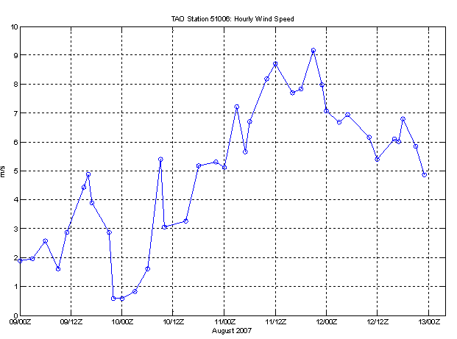




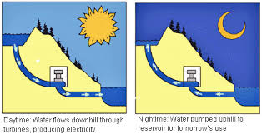
Variable Generations (V.G.) Forecasting
Why Forecast?
P_{G} = P_{D} + P_{loss}
Renewables Generations
(Wind and Solar) are Too Variable
High Efficiency and Large Energy Storage
Still not Exist
Reducing
Cost
and Pollution

Slide 5
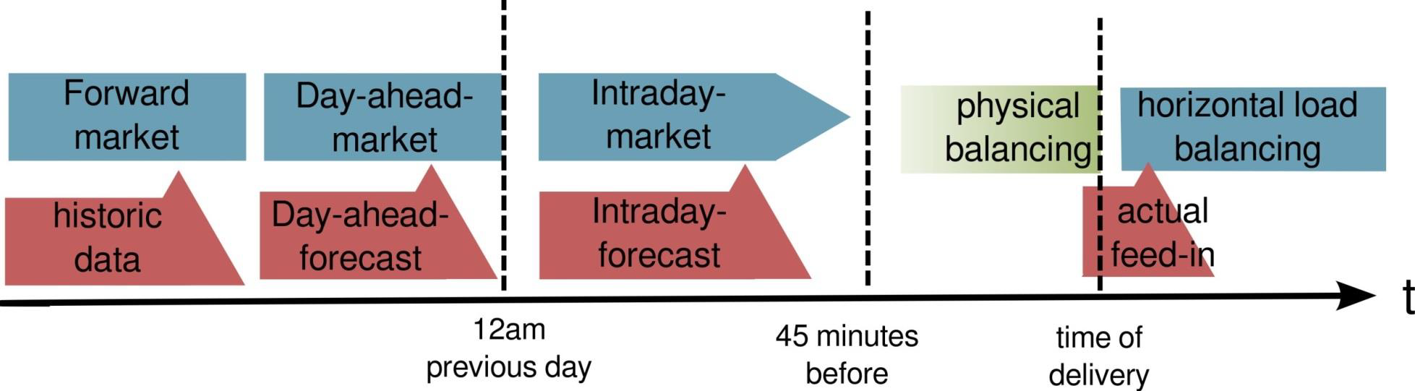
Variable Generations (V.G.) Forecasting
Where Forecast?
Forecast horizons, forecasting models and the related applications of VG forecasts
Forecast Horizons
VG forecasting in US. electric utilities and ISO, such as CAISO, ERCOT, MISO, ISO-NE, NYISO,…etc.
Botterud, J. Wang, V. Miranda, and R. J. Bessa, “Wind power forecasting in US electricity markets,” The Electricity Journal, vol. 23, no. 3, pp. 71–82, 2010.
Elke Lorenz, “Solar Resource Forecasting” International Solar Energy Society (ISES) Webinar, 2016.
Voyant, C., Notton, G., Kalogirou, S., Nivet, M. L., Paoli, C., Motte, F., & Fouilloy, A. (2017). Machine learning methods for solar radiation forecasting: A review. Renewable Energy, 105, 569-582.

Slide 6
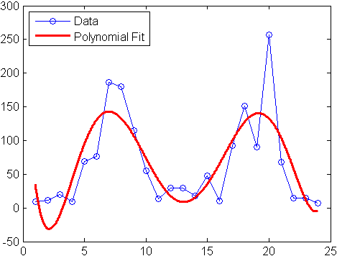
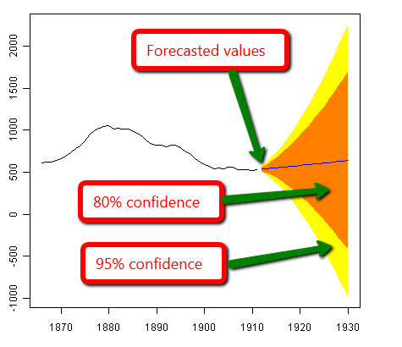
Solar Power Forecasting
How Forecast?
Regression
Extrapolation
Flowchart of the Combined Approach (Physical and Statistical) of the Solar Power Forecasting

Slide 7
Flowchart of the Solar Power Forecasting
Hourly Probabilistic Forecasting of Solar Power

Slide 8
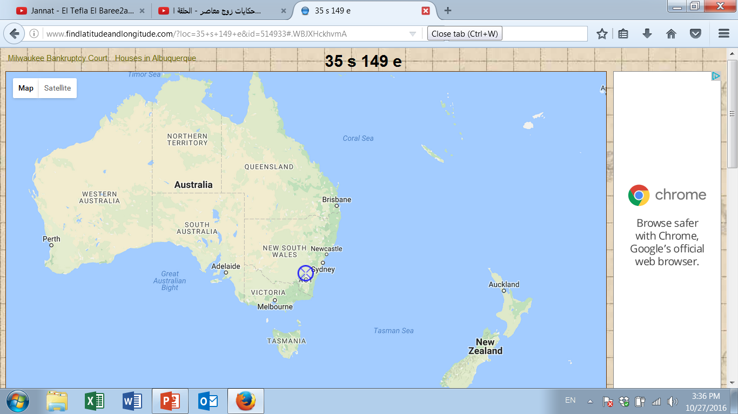
Hourly Probabilistic Forecasting of Solar Power
Data Description:
PV solar system is near Canberra, Australia, consisting of 8 panels, its nominal power of (1560W), and panel orientation 38° clockwise from the north, with panel tilt (of 36°). The historical observed solar power data are normalized to the rated capacity (i.e., 1560W).
No. | Input Variable, (X)
1 | Cloud Water Content
2 | Cloud Ice Content
3 | Surface Pressure
4 | Relative Humidity
5 | Cloud Cover
6 | 10m - U Wind
7 | 10m - V Wind
8 | 2-m Temperature
9 | Surface solar radiation down
No. | Input Variable, (X)
10 | Surface thermal radiation down
11 | Top net solar radiation
12 | Total precipitation
13 | Heat Index
14 | Wind Speed
15 | Hours
16 | Months
17 | Days of Month
18 | Days of Year
Weather predictions are produced by a global numerical weather prediction system, European Centre for Medium-Range Weather Forecasts (ECMWF).
Data partition into training and testing sets
Timeline | Month | Year | Partition
From | April | 2012 | Training Set
To | May | 2013
From | June | 2013 | Testing Set
To | May | 2014
https://crowdanalytix.com/contests/global-energy-forecasting-competition-2014-probabilistic-solar-power-forecasting
http://www.ecmwf.int (European Centre for Medium-Range Weather Forecasts)

Slide 9
Forecasting Models
Parametric and Nonparametric Models
Multiple Linear Regression (MLR) Analysis, Artificial Neural Networks (ANN), and Support Vector Regression (SVR) are deployed for the short-term solar power forecasting.
New Input X
Training Set
Solar Power Forecast
Learning Algorithm
Predicted Output Y
Flowchart of the forecasting models
Building the Model
Training
Validation
Testing
Flowchart of solar forecasting model building steps
T. Hastie, R. Tibshirani, J. Friedman, and others, The elements of statistical learning, 2nd Edition. Springer-Verlag New York, 2009.

Slide 10
Ensemble Forecasts
Combining Various Models
Individual Forecasts of PV Solar Power
Model A
Ensemble Learning (RF) for Combining of Forecasts
Model B
Combined Forecasts
Model N
Weather Data
General diagram of combining different models
F_{comb}=W_{A}*M_{A}+ W_{B}*M_{B} + W_{C}*M_{C} ….+ W_{N}*M_{N}
W_{N} is a weight is assigned to the outcome of a model M_{N}
Methods of Combining The Models
Random forest (RF) is chosen to be the ensemble learning method for combining the various models’ outcomes.
T. Hastie, R. Tibshirani, J. Friedman, and others, The elements of statistical learning, 2nd Edition. Springer-Verlag New York, 2009.

Slide 11

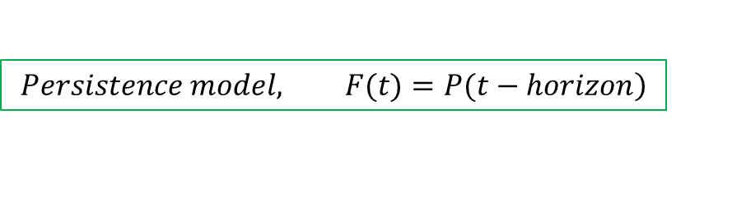
Ensemble Forecasts
Persistence model and day-ahead Forecasts from MLR, ANN and SVR
Day | Month
1 : | June
: | July
: : : | : : :
: | April
30 | May
31 | 00:00 : 23:00
Weather Data
: : | : :
: | :
: : : | : : :
: | :
: | :
: : : | : : :
PV Power
: : | (Past Observations)
:
: : :
:
:
Forecasts (Model’s Outcomes)
Day | Month
1 : | June
: | July
: : : | : : :
: | April
30 | May
31 | 00:00 : 23:00
Weather Data
: : | : :
: | :
: : : | : : :
: | :
: | :
: : : | : : :
Models’ Outcomes
: : | : : | : :
: | : | :
: : : | : : : | : : :
: | : | :
: | : | :
Forecasts
PV Power
: : | (Past Observations)
:
: : :
:
:
Combined Forecasts
at 00:00
(a)
(b)
Producing Different Models’ Outcomes
Combining by Radom Forest
Schematic diagram of producing and ensemble different models’ outcomes
$$\left.Persistence model, F(t)=P(t−horizon\right)$$
$$Here the horizon=1hour$$

Slide 12
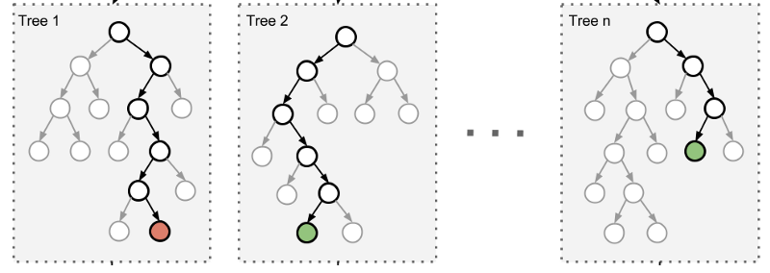
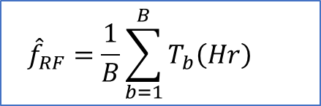
Probabilistic Forecasts
Ensemble-based probabilistic forecasts method:
NWP point forecasts
Solar power point forecasts
Probabilistic model
Probabilistic forecasts of solar power
(a)
Diagram of ensemble-based probabilistic forecasts,
Splitting mechanism of trees in random forest,
Sample of ensemble-based probabilistic forecasts of solar power of 3 days
(b)
(c)
$${\hat{f}}_{RF}=\frac{1}{B}\sum_{b=1}^{B}{T_{b}\left(Hr\right) }$$

Slide 13


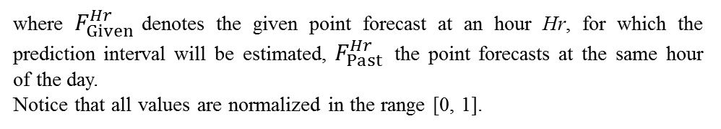
Probabilistic Forecasts
Analog Ensemble (AnEn) method:
Schematic diagram of analog ensemble method
$$\left|F_{Given}^{Hr}−F_{Past}^{Hr}\right|≤ε$$
where $F_{Given}^{Hr}$denotes the given point forecast at an hour Hr, for which the prediction interval will be estimated, $F_{Past}^{Hr}$ the point forecasts at the same hour of the day.
Notice that all values are normalized in the range [0, 1].
$ε$= 0.1
S. Alessandrini, L. Delle Monache, S. Sperati, and G. Cervone, “An analog ensemble for short-term probabilistic solar power forecast,” Appl. Energy, vol. 157, pp. 95–110, 2015.

Slide 14
Probabilistic Forecasts
Persistence probabilistic forecasts method:
No past forecasts are needed.
Schematic diagram of analog ensemble method
The 10, 20 and 30 recent observed powers are carried out.
It is found that the recent 10 observed solar powers at the given hour with CDF distribution achieve more accurate persistence probabilistic forecasts.

Slide 15
Probabilistic Forecasts
Probability distributions by the cumulative distribution function (CDF)
➔For example, for a given point forecast at 14:00, June 2nd 2013:
Histogram of the ensemble of RF’s outcomes
Different distributions of probability
Linear CDF
Max
Min
to derive CDF
Parametric normal- distributed CDF
Mean
Std. dev.
to derive CDF.
Nonparametric CDF
No mean
neither Std. Dev.
CDF is estimated by piecewise nonparametric method
The probabilistic forecasts are estimated by using CDF⁻¹

Slide 16
Probabilistic Forecasts
Probability distributions by the cumulative distribution function (CDF)
➔For example, for a given point forecast at 12:00, May 29th 2014:
Histogram of the ensemble of RF’s outcomes
Different distributions of probability
Linear CDF
Max
Min
to derive CDF
Parametric normal- distributed CDF
Mean
Std. dev.
to derive CDF.
Nonparametric CDF
No mean
neither Std. Dev.
CDF is estimated by piecewise nonparametric method
The probabilistic forecasts are estimated by using CDF⁻¹

Slide 17
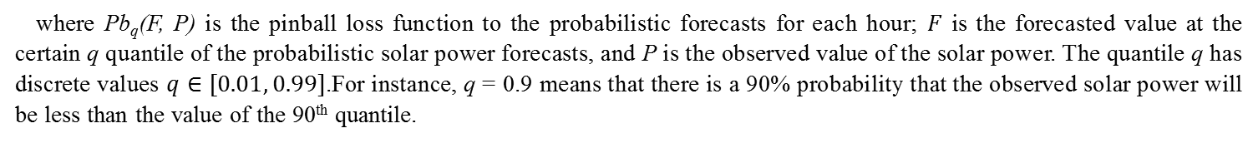
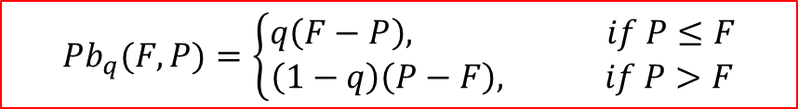
Probabilistic Forecasts
Evaluation of probabilistic forecasts:
The objective is to determine probabilistic solar forecasts in the form of probabilistic distribution (in quantiles) in incremental time steps through the forecast horizon.
A Pinball loss function is used to evaluate the accuracy of the probabilistic forecasts. It is a piecewise linear function which is often used to evaluate the accuracy of quantile forecasts.
$${Pb}_{q}(F, P)=\left\{\begin{matrix}q\left(F−P\right), if P≤F \\ \left(1−q\right)\left(P−F\right), if P>F\end{matrix}\right.$$
where Pb_{q}(F, P) is the pinball loss function to the probabilistic forecasts for each hour; $F$ is the forecasted value at the certain q quantile of the probabilistic solar power forecasts, and P is the observed value of the solar power. The quantile q has discrete values $q∈[0.01, 0.99]$.For instance, q = 0.9 means that there is a 90% probability that the observed solar power will be less than the value of the 90th quantile.
J. M. Morales, A. J. Conejo, H. Madsen, P. Pinson, and M. Zugno, Integrating renewables in electricity markets - Operational problems, vol. 205. Boston, MA: Springer US, 2014.

Slide 18
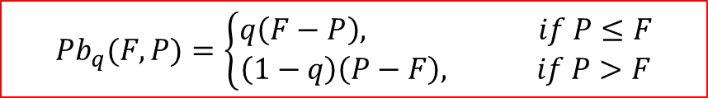
Results and Evaluation
Pinball loss function (Pb):
$${Pb}_{q}(F, P)=\left\{\begin{matrix}q\left(F−P\right), if P≤F \\ \left(1−q\right)\left(P−F\right), if P>F\end{matrix}\right.$$
The lower Pinball (Pb) is, the more accurate probabilistic forecasts are.
Graphs of the probabilistic forecasts of the three methods for three days

Slide 19
Results and Evaluation
Pinball loss function (Pb):
$${Pb}_{q}(F, P)=\left\{\begin{matrix}q\left(F−P\right), if P≤F \\ \left(1−q\right)\left(P−F\right), if P>F\end{matrix}\right.$$
The lower Pinball (Pb) is, the more accurate probabilistic forecasts are.
Monthly Pinball of the probabilistic forecasts of the three methods

Slide 20
Results and Evaluation

Slide 21
Conclusions
The probabilistic forecasting are quantifying the uncertainty associated with point forecasts.
Combining the forecasts of various models leads to accurate point and probabilistic forecasts.
Throughout the complete year, the ensemble based-probabilistic forecasts are more accurate. than the analog ensemble and persistence probabilistic forecasts.
The random forest is a powerful ensemble learning method.
The CDF with the assumption of a normal distribution is better than the linear distribution to produce the probabilistic forecasts.
The nonparametric estimation of CDF without the normality assumption yields a small improvement (Pb=0.0100 vs. Pb=0.0102 with a normality assumption of CDF).
With additional historical data, the forecasting performance could be improved.

Slide 22

Thanks for Your Listening
Any Question?
Mohamed Abuella
mabuella@uncc.edu
http://epic.uncc.edu/
Energy Production and Infrastructure Center
University of North Carolina at Charlotte

